Slide 1
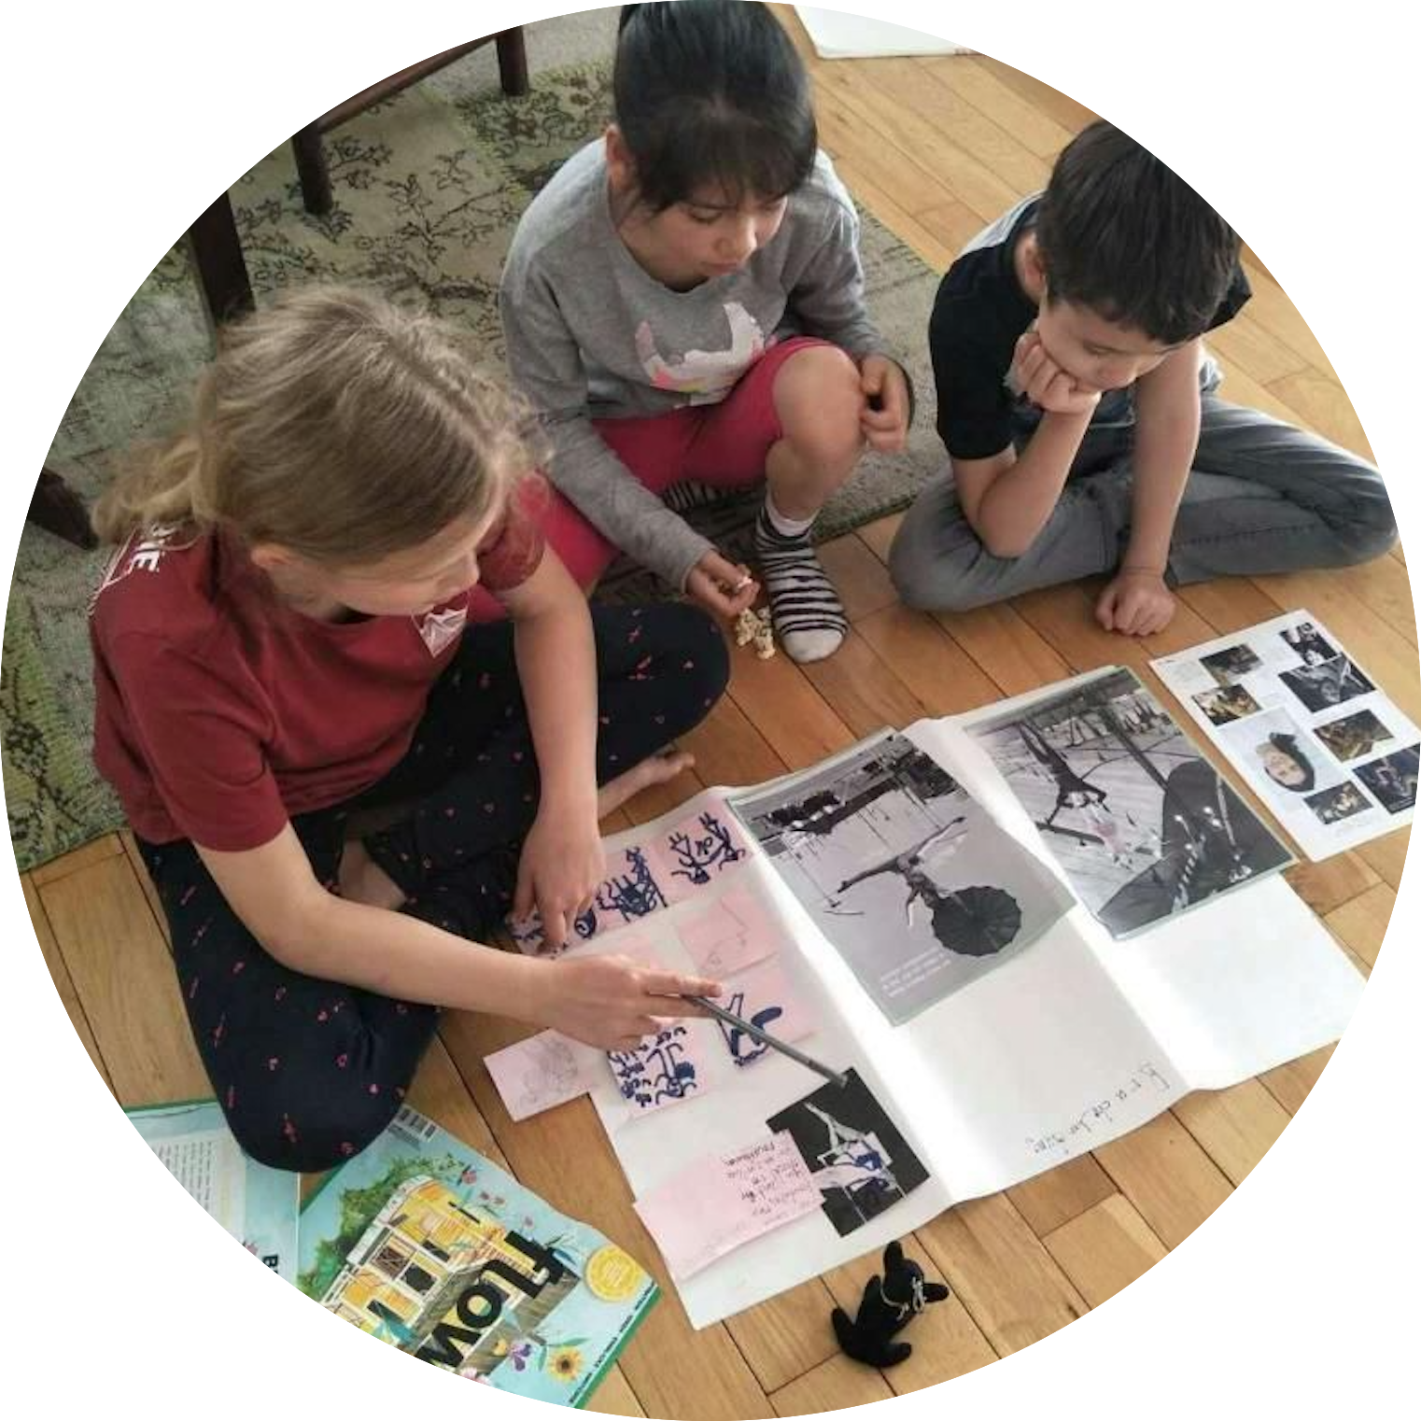
Agile Kids Workshop
Embrace the Future - Embrace Uncertainty

Slide 2
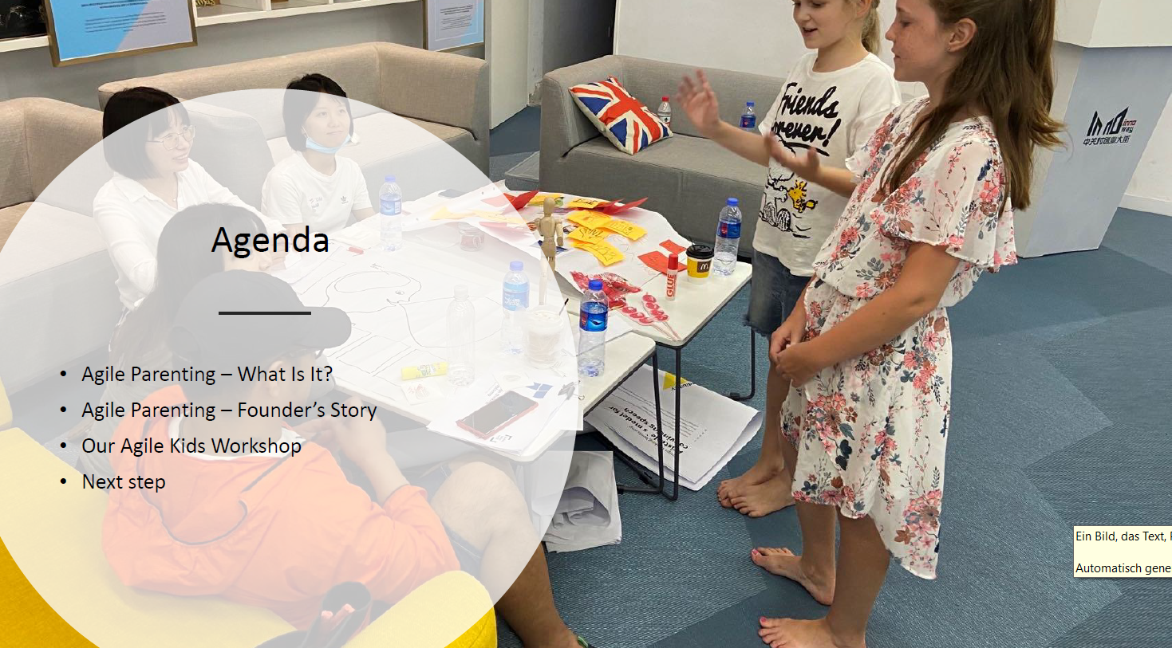

Slide 3
What is Agile Parenting?
It does not have strict rules and
do-s and don‘t-s.
It sets up a framework and space for kids to grow up happily and without fear.
It is very personal. YOU define your purpose of agile and then pick the tools and methods accordingly. Not the other way round.

Slide 4
What is Agile Parenting?
It is based on the principles of agile mindset & management framework.
Plays with its tools, methods and the radically customer-centric and purpose-driven mindset.
Gave us a grip in this challenge:
How do we help our children to enter the world?

Slide 5
Agile Kids
Workshop

Slide 6
Happy Family Equation
We follow our happy family equation with a playful, open and practical approach by applying our experience learning method
Mindset: We help to build up an eco-system
of family environment
Knowledge: get to know the theory about
Tools: help to bridge theory to real life

Slide 7
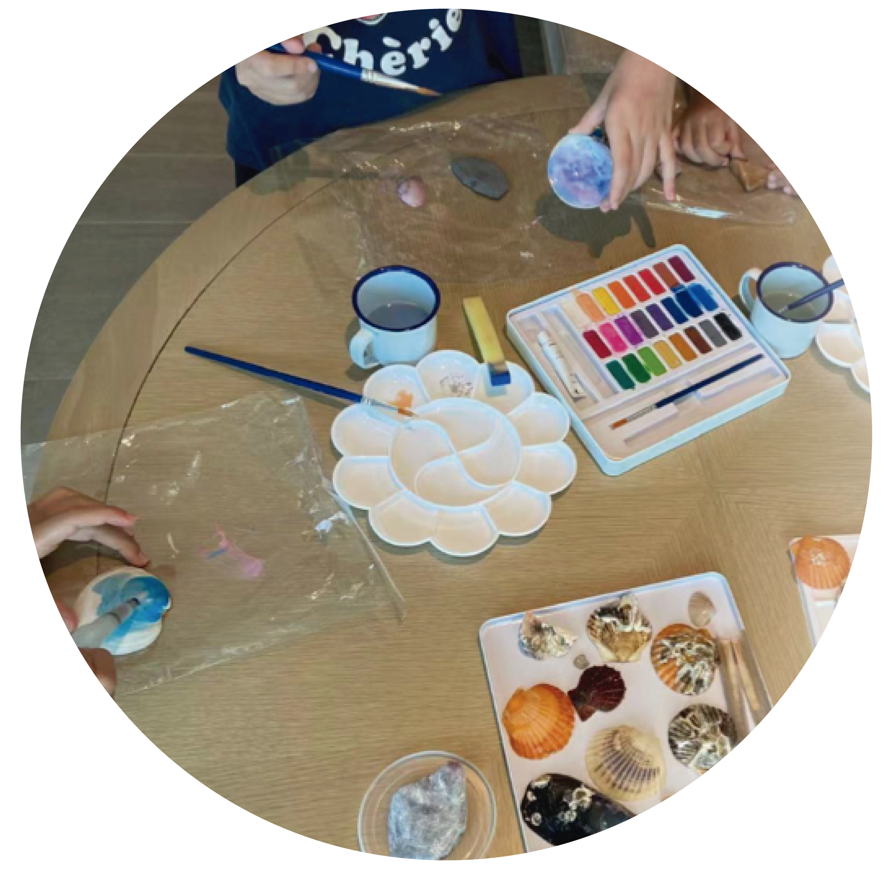
Agile Kids Workshop Experience Agile with Sophie & Wang Man!
Agenda
14:00 –14:15:
Welcome & Ice Breaking
14:15 –14:35:
Embrace Future, Embrace Uncertainty – Intro to the World of Agile
14:35 –15:00:
Agile Game – Experience the Power of Agility
15:00 –15:45:
Agile Parenting Power Tool Intro – Family Challenge Board
15:45 –16:00:
Feedback & Closing

Slide 8
Tool: Family Challenge Board!
One Family
One Week
One Challenge
Each of us gets
a grip on a
bad habit!

Slide 9
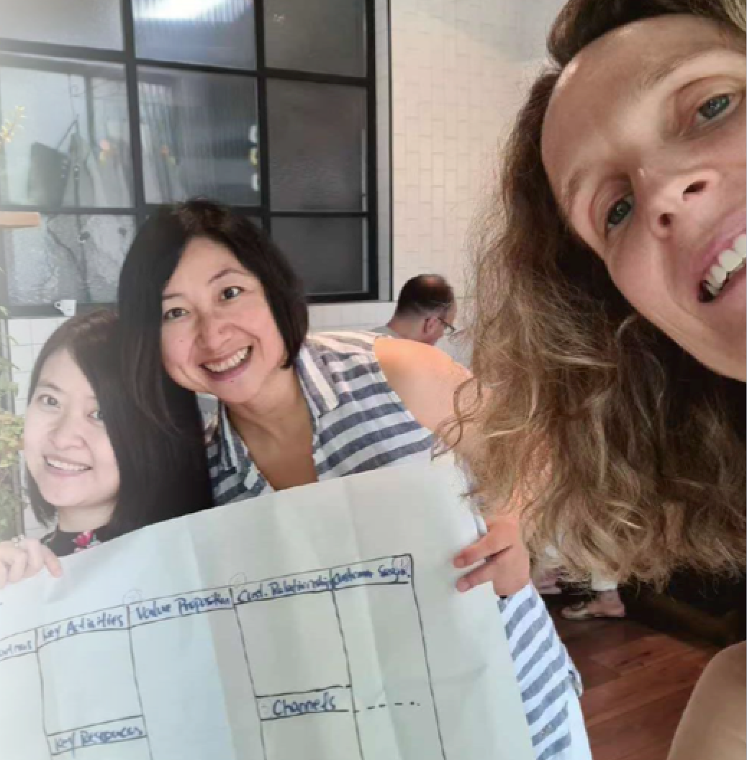
3 FRIENDS, 2 CONTINENTS, 1 IDEA!
Our names are Brigitte, Wang Man and Xiaoman and we share ONE idea: Agile Parenting.
We live in Europe and in China.
We are entrepreneurs, curators and management consultants. And many other things to our clients and we love our jobs because they let us grow to our full potential and explore life.
We love our friends, family and most of all our kids - who are the most gifted, beautiful and adorable children in the world.
In 2020, we had this inspiration about Agile Parenting and started to experiment with agile tools and methods, and build up communities for parents to share their stories!

Slide 10
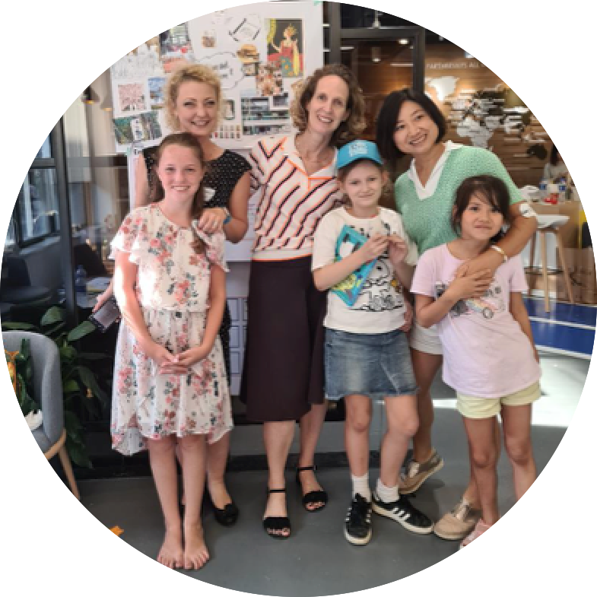
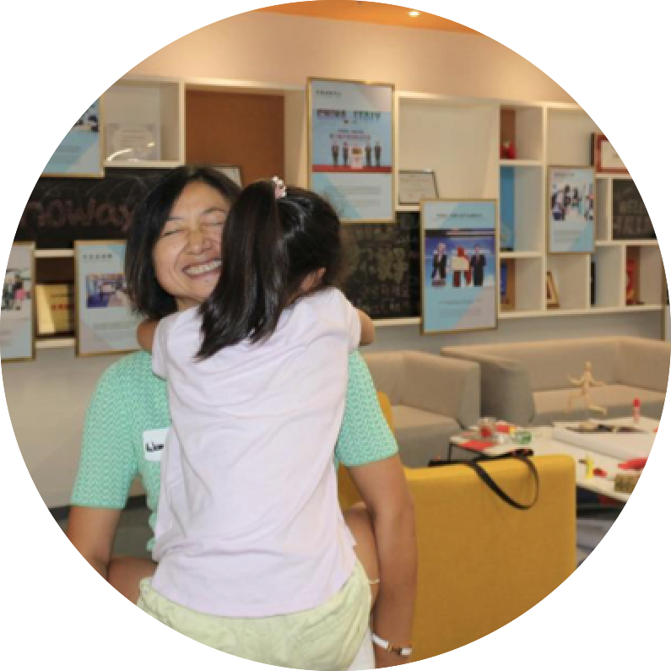
Agile Kids Workshop Experience Agile with Sophie & Wang Man!
We follow our happy family equation with a playful, open and practical approach by applying our experience learning method

